Slide 1
AIR-FARE PREDICTION

Slide 2
MEMBERS
Anurag Gupta
Tarun Kumar
Vishvander Sharma
Vimal Kumar

Slide 3

01
Business Problem
02
Data Fetch & Why we take 2019 data
CONTENTS
03
Problems we faced in dataset
04
Analysis
05
Model & Deployment

Slide 4

Business Problem…
For a traveller it is important to know the fare value of a trip, and as prices of flight ticket varies abruptly and it becomes hectic for a user to check different websites, use different deals. A flight fare prediction model will help inform the travellers with the optimal time to buy their flight tickets and understand trends in the airline industry.

Slide 5
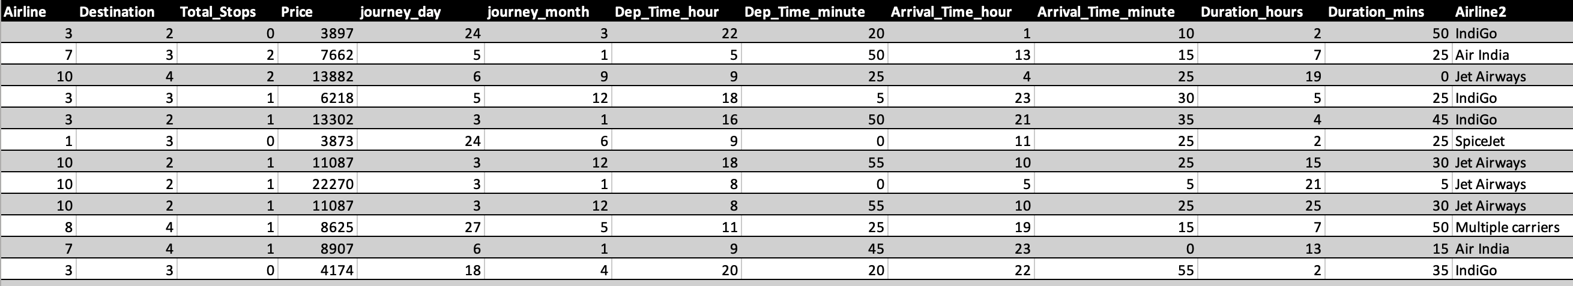
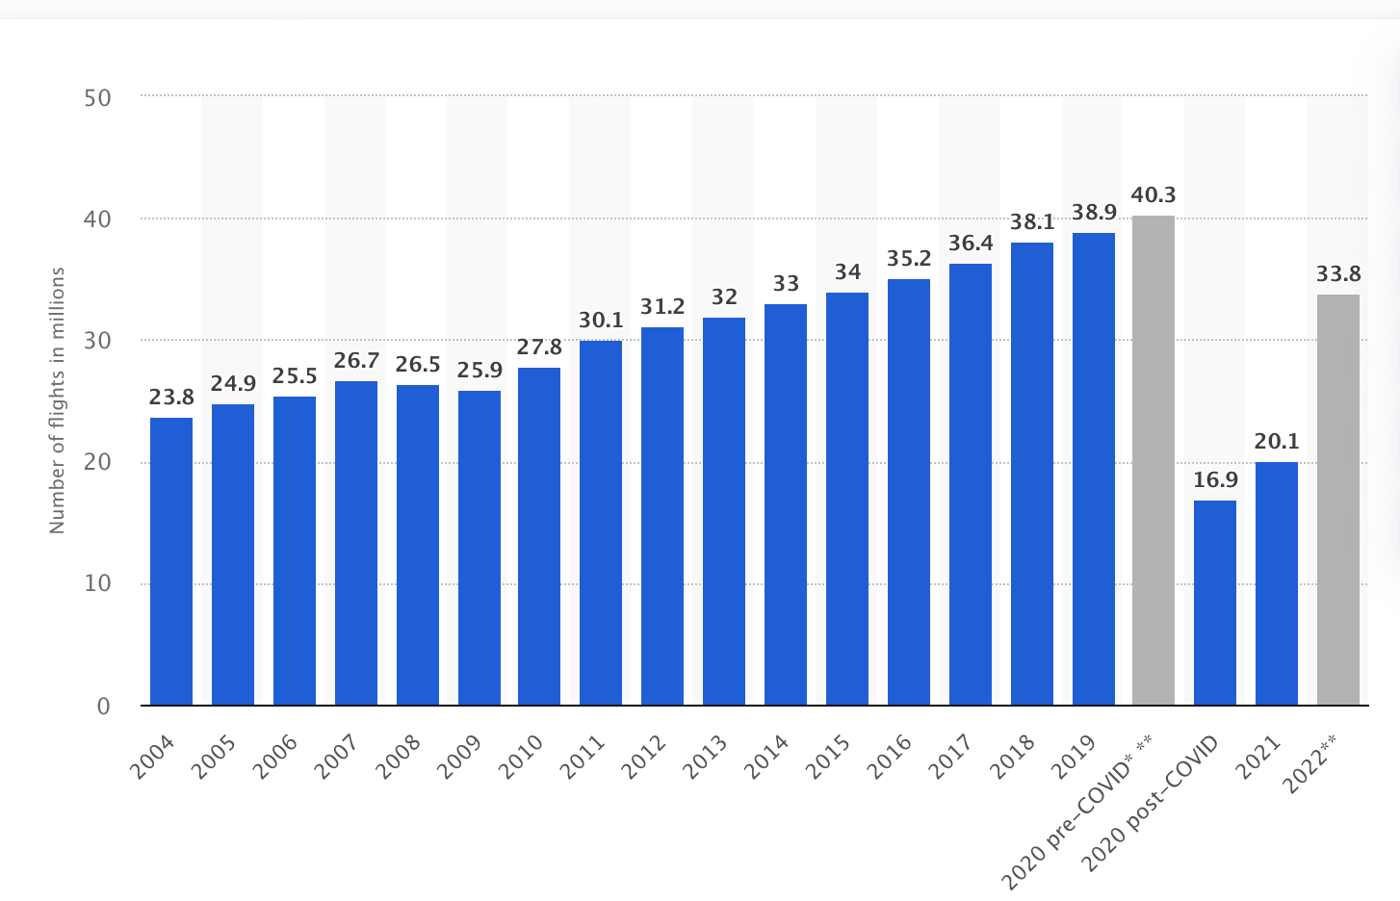
Data Fetch & Why we take 2019 Data…
Statista.
We are using 2019 data as it represents the most recent period with stable data prior to the onset of the COVID-19 pandemic, for which there is no consistent data available afterwards.

Slide 6
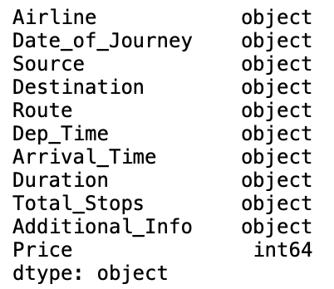
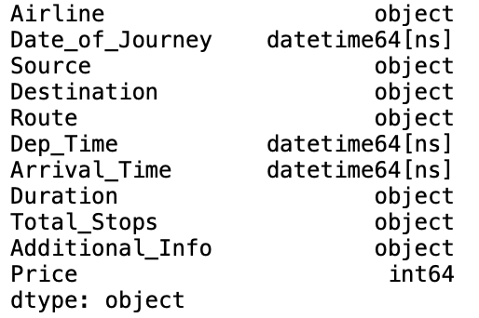
Problems we faced in the Dataset…
Null Values Treatment.
Date & Time columns have an object datatype.
to_datetime
Before
After
Outlier.

Slide 7
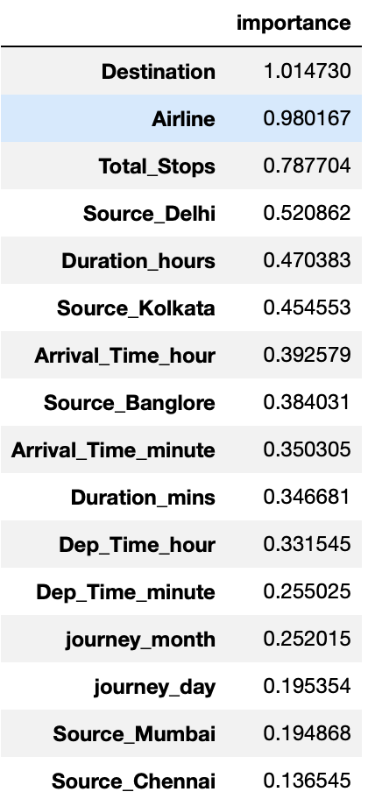
….…
Encoding Techniques.
One-Hot Encoder
Label Encoder
Performing Feature Selection.

Slide 8
ANALYSIS

Slide 9
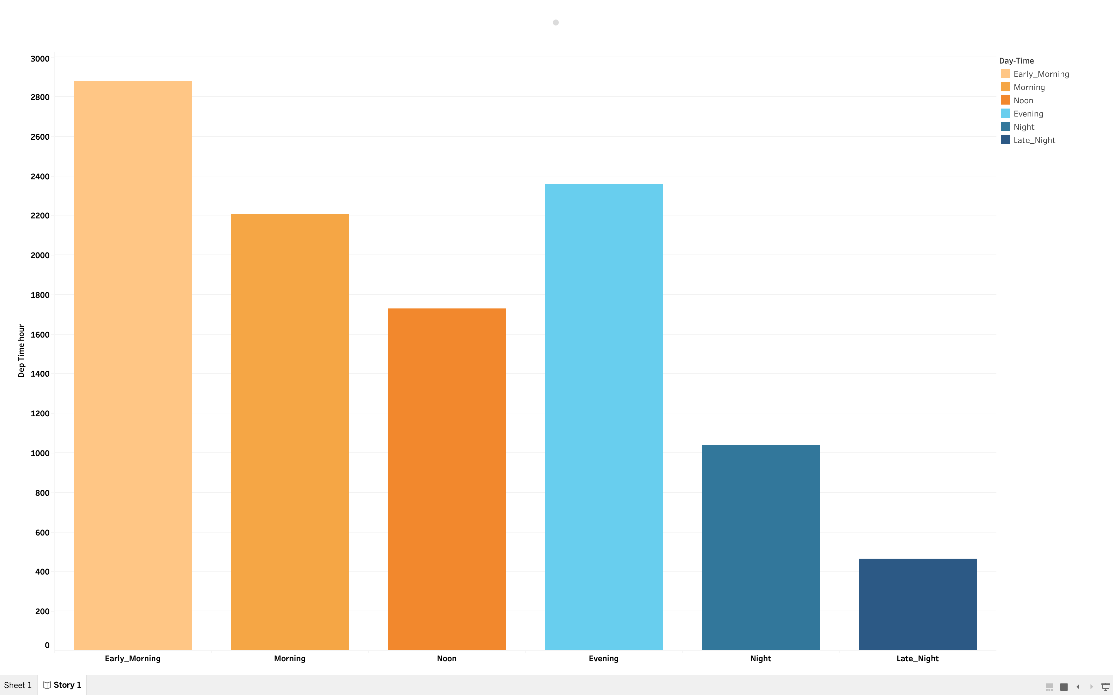
When is the major time slot for most flight departures ?

Slide 10
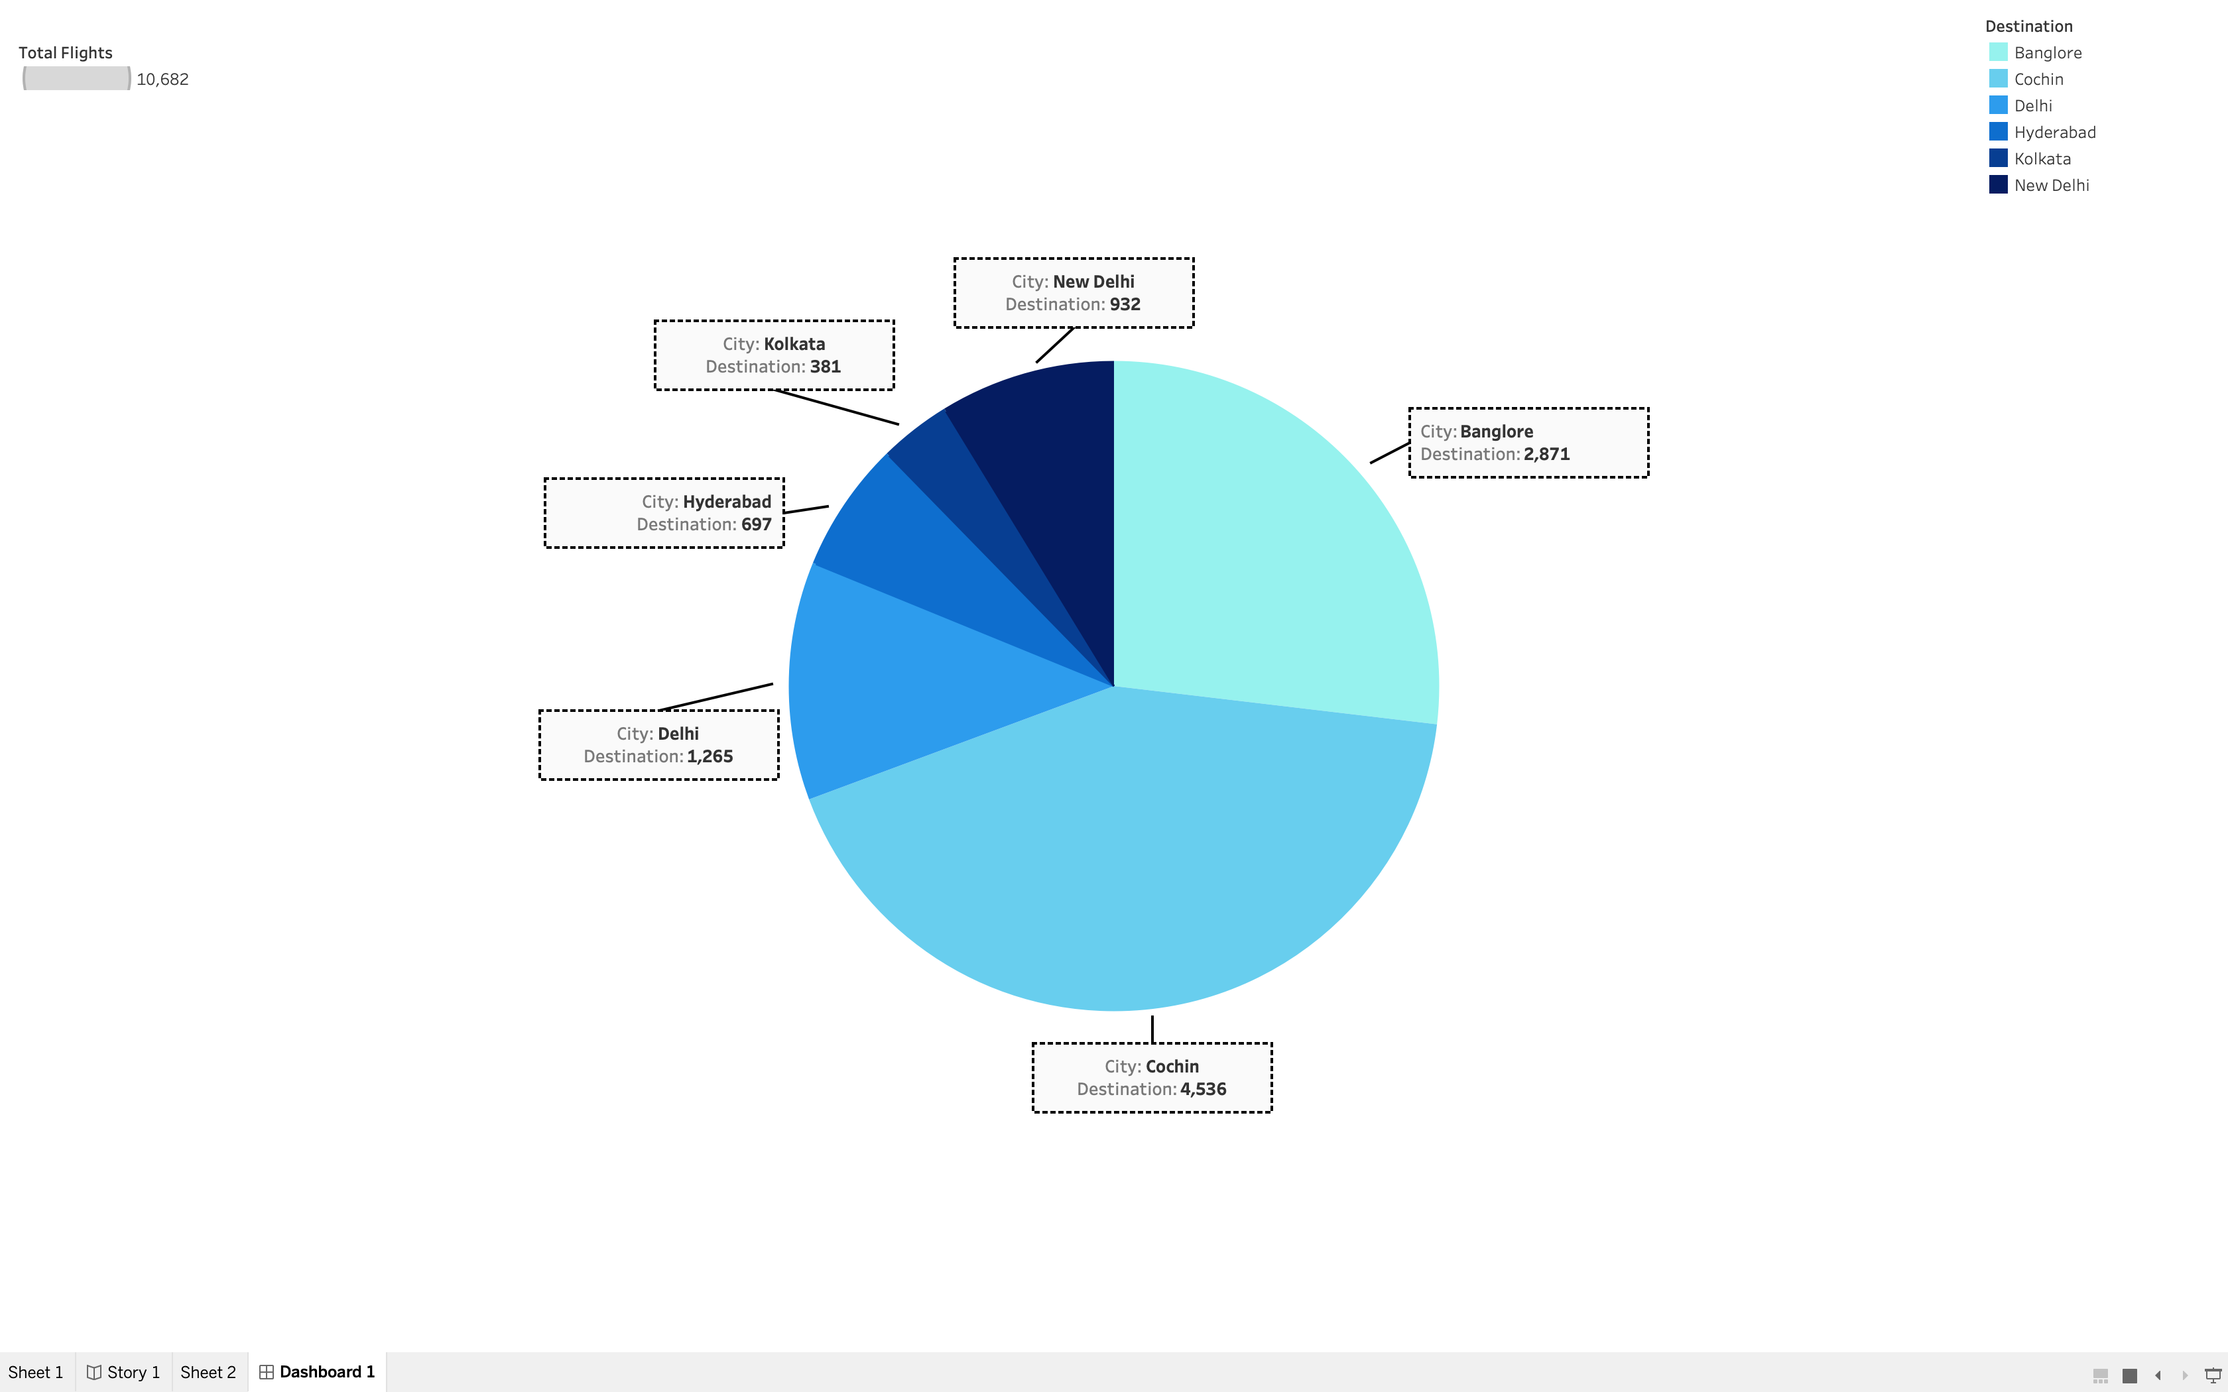
Which city has the highest number of flights ?

Slide 11
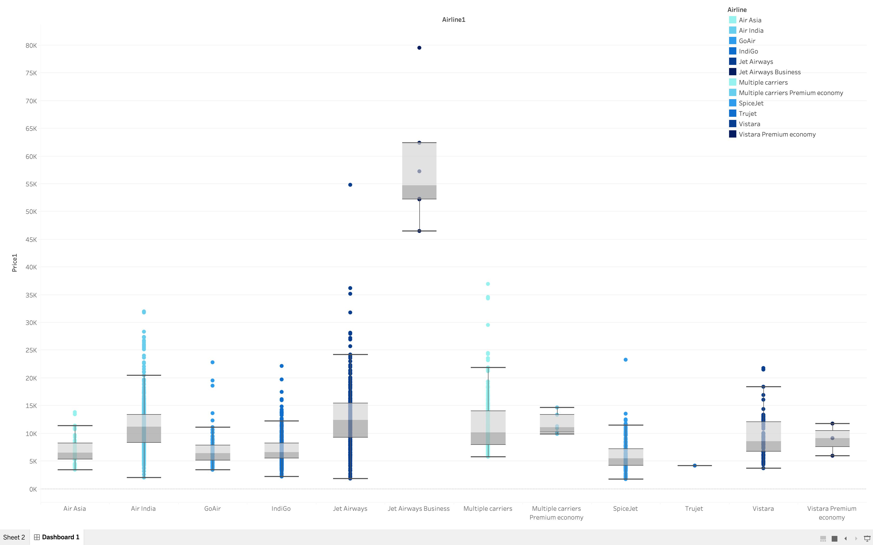
What is the Airline with the highest price ?

Slide 12
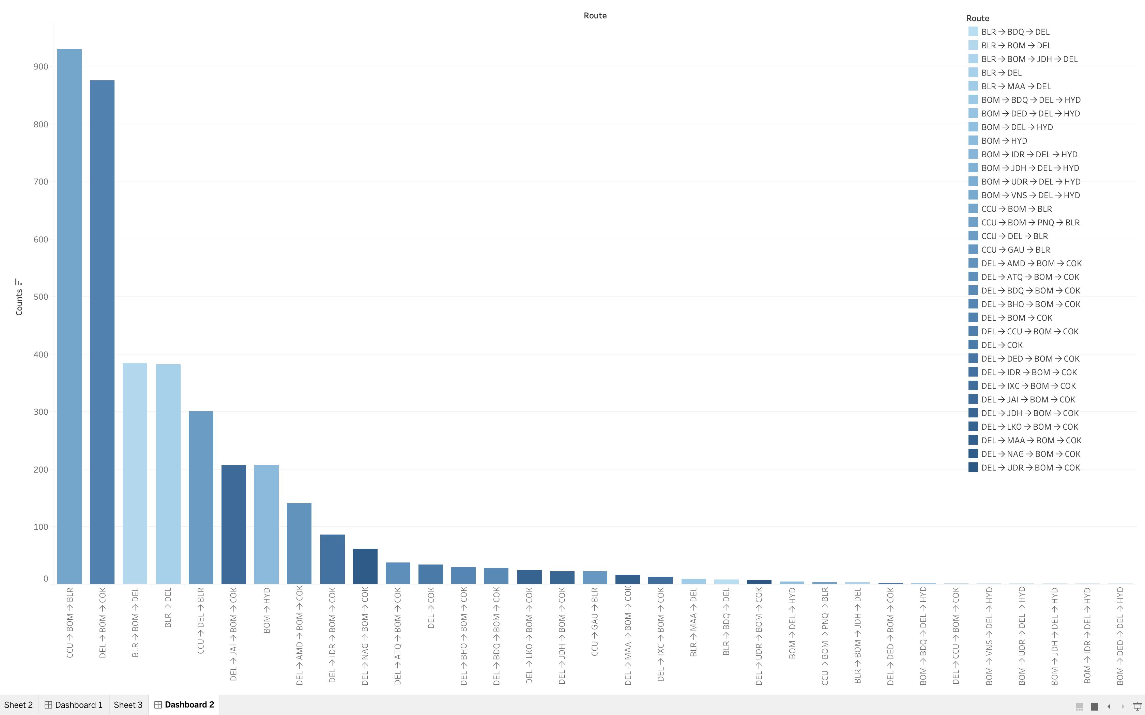
Which routes see the highest usage of jet airways ?

Slide 13
DASHBOARD

Slide 14
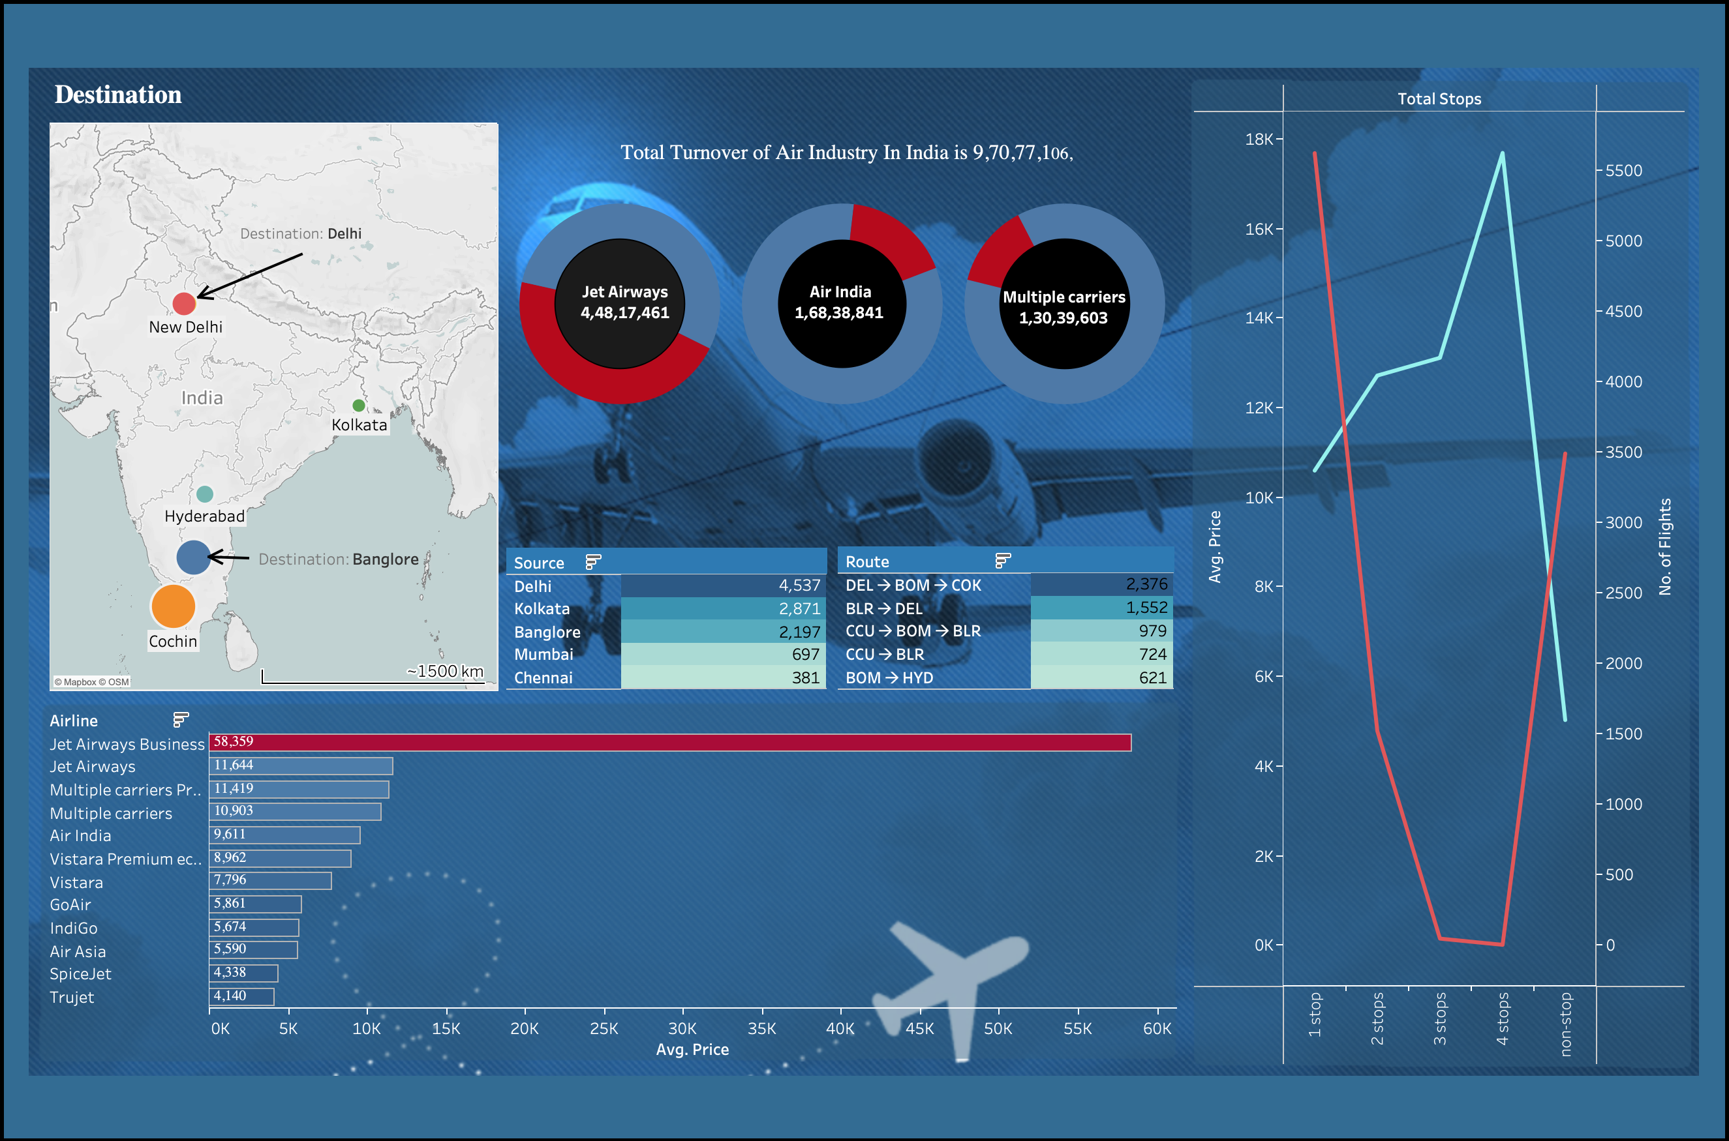

Slide 15
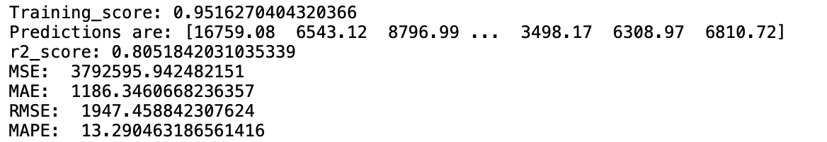
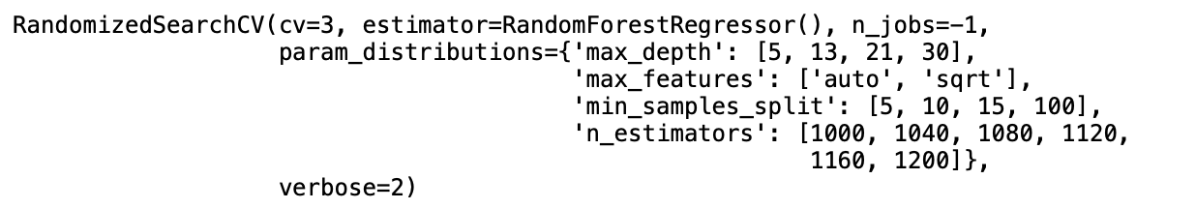
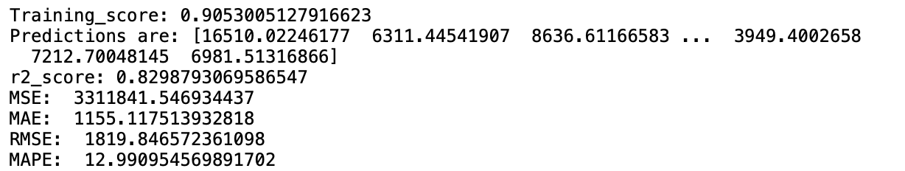
Model…
Random-Forest Regressor.
Hyperparameter Optimization.
RandomizedSearch-CV
Best Parameter in RandomizedSearch-CV
{'n_estimators': 1040, 'min_samples_split': 10, 'max_features': 'auto', 'max_depth': 13}
Prediction

Slide 16
..…
Dump Load ML Model.

Slide 17
Web-site Overview
Replace with your own text

Slide 18
THANK YOU

